Slide 1
Welcome
PowerPoint Presentation
ON
Unit-1, Lesson-3
Two Women
Prepared by
Md. Tarikul Ghani

Slide 2
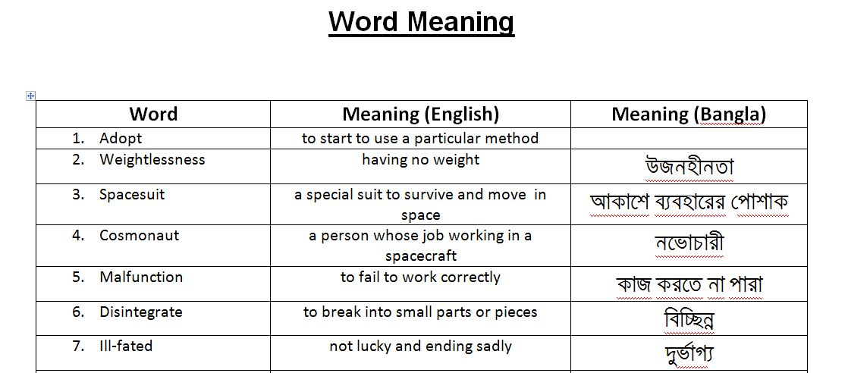

Slide 3
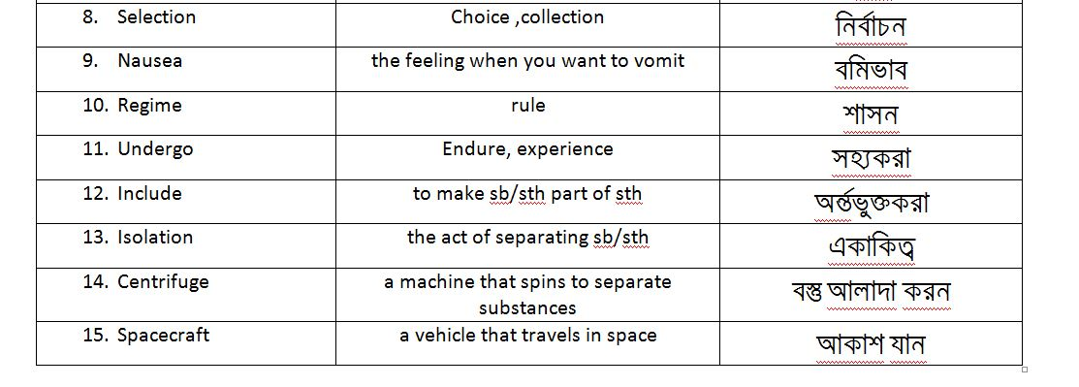

Slide 4
Write down the following Questions correctly and give answer
About Valentina Tereshkova
a. Where …… ……. born?
b. When ………………………………………. as a cosmonaut?
c. When …………………………………………….. first space flight?
d. How old ……………………………………………. then?
e. How ……………………………………………………… feel in the spacecraft?
f. Who ……………………………………………………… talk to from the space?
g. What ........................................... want to do now?

Slide 5
About Kalpana Chawla
a. Where………………………………………… born?
b. When ……………………. her first flight?
c. Why ………………………. to USA?
d. Why ……………………………. NASA?
e. What ……………………………………………. in 1997?
f. How ………………………………………………… die?
g. What …………………………………………….. make?

Slide 6
Thank You

